Slide 1



AGE-FRIENDLY NEEDS ASSESSMENT & ACTION PLAN
TOWNSHIP OF VERONA CHRIS SOTIRO
TOWNSHIP COUNCIL MEETING
CSOTIRO@NJFUTURE.ORG
JULY 6, 2026

Slide 2
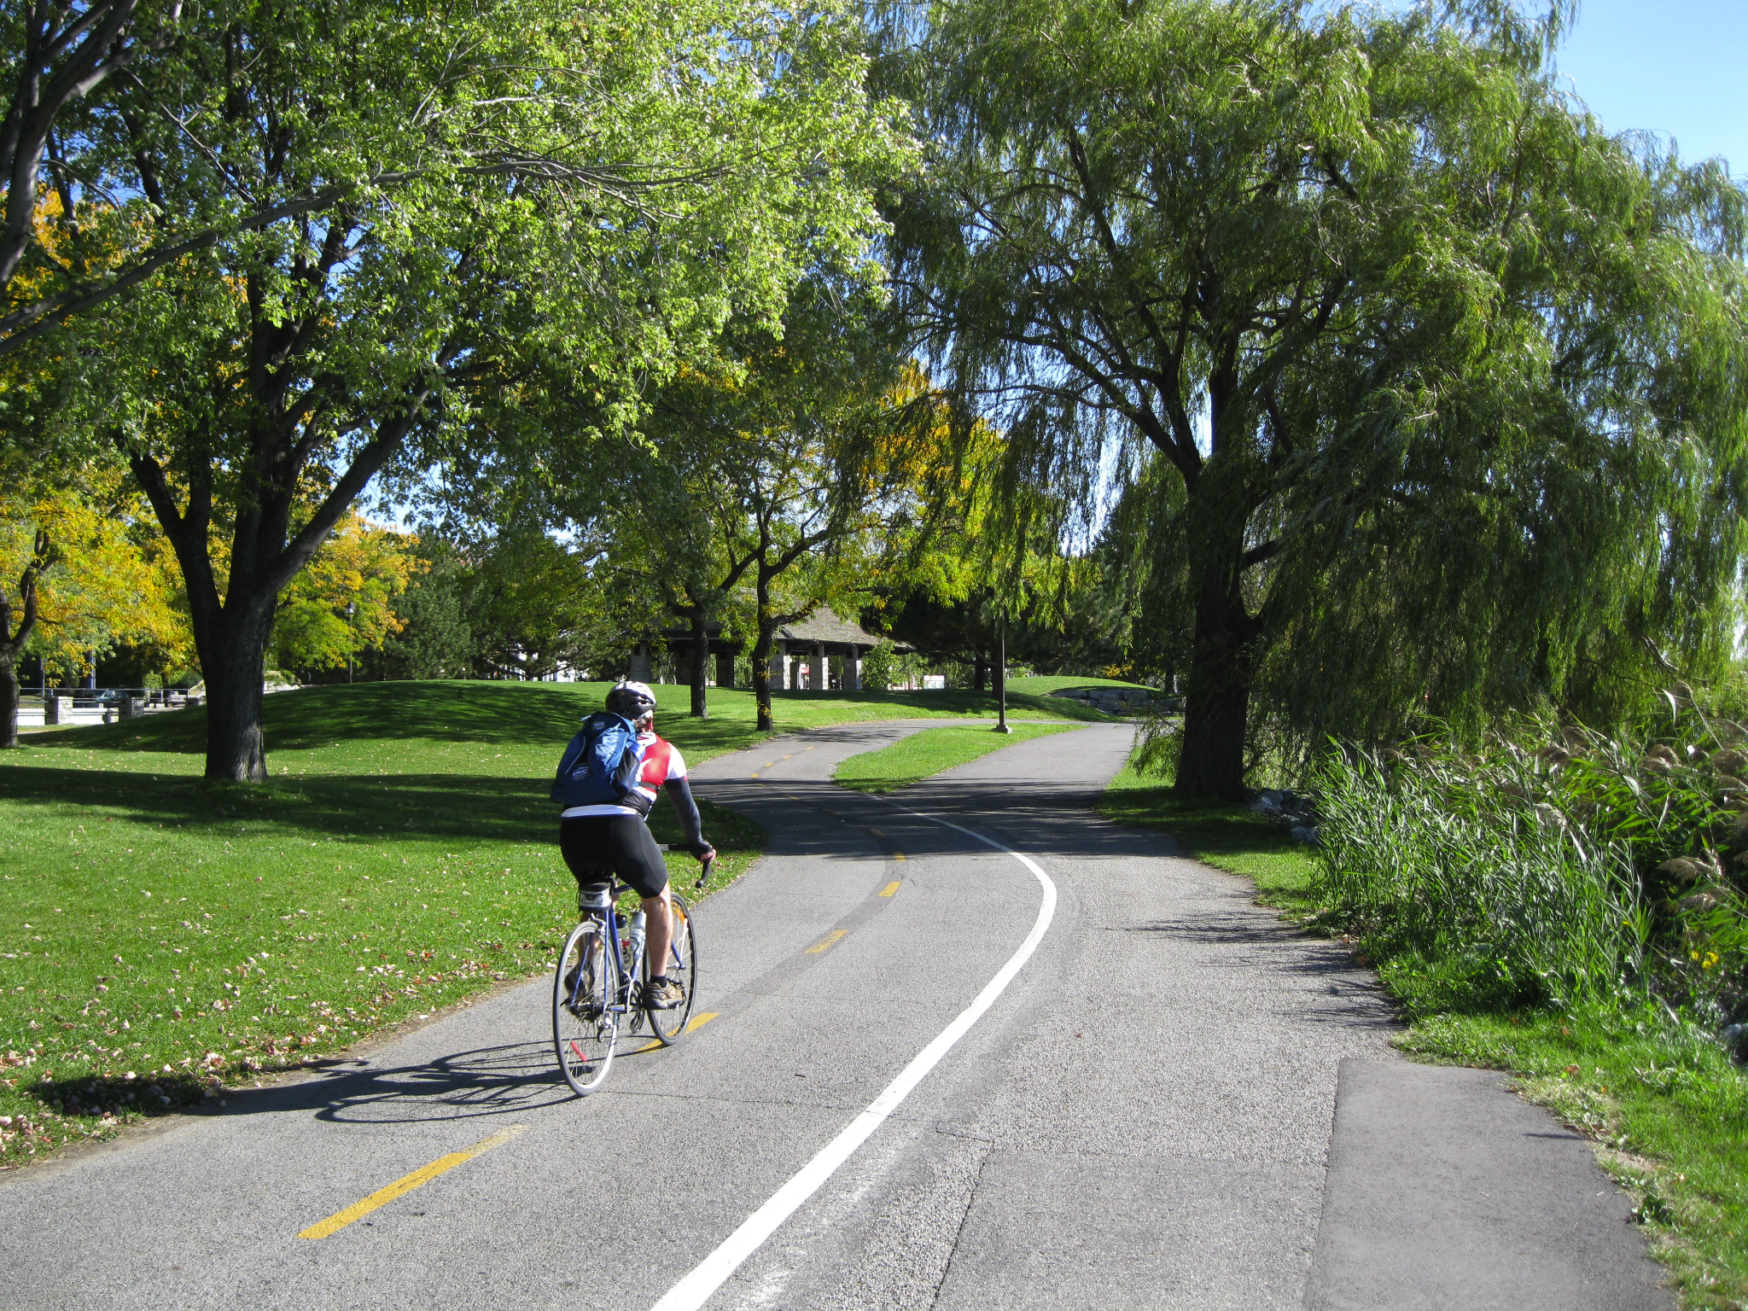
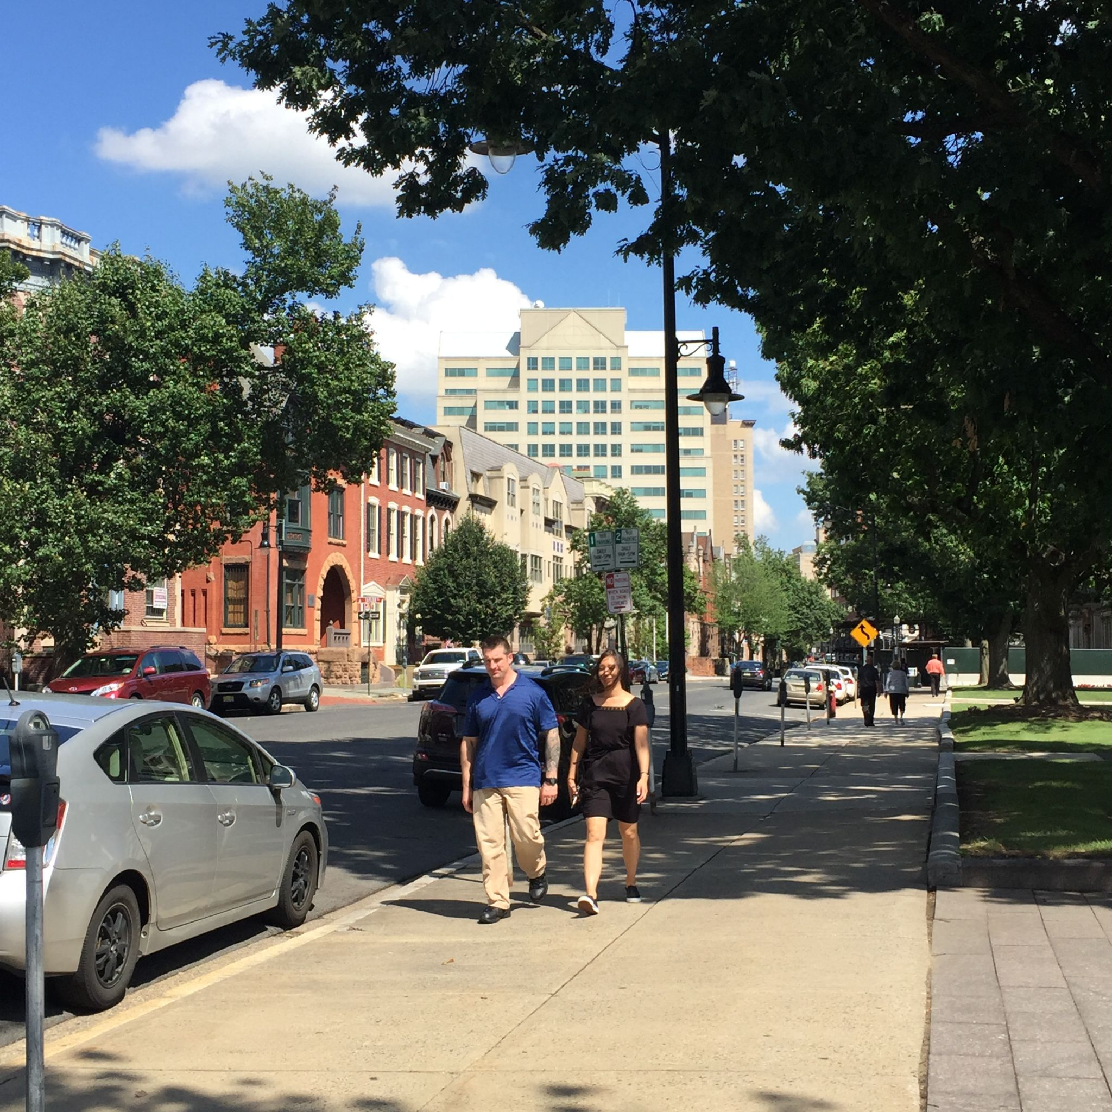
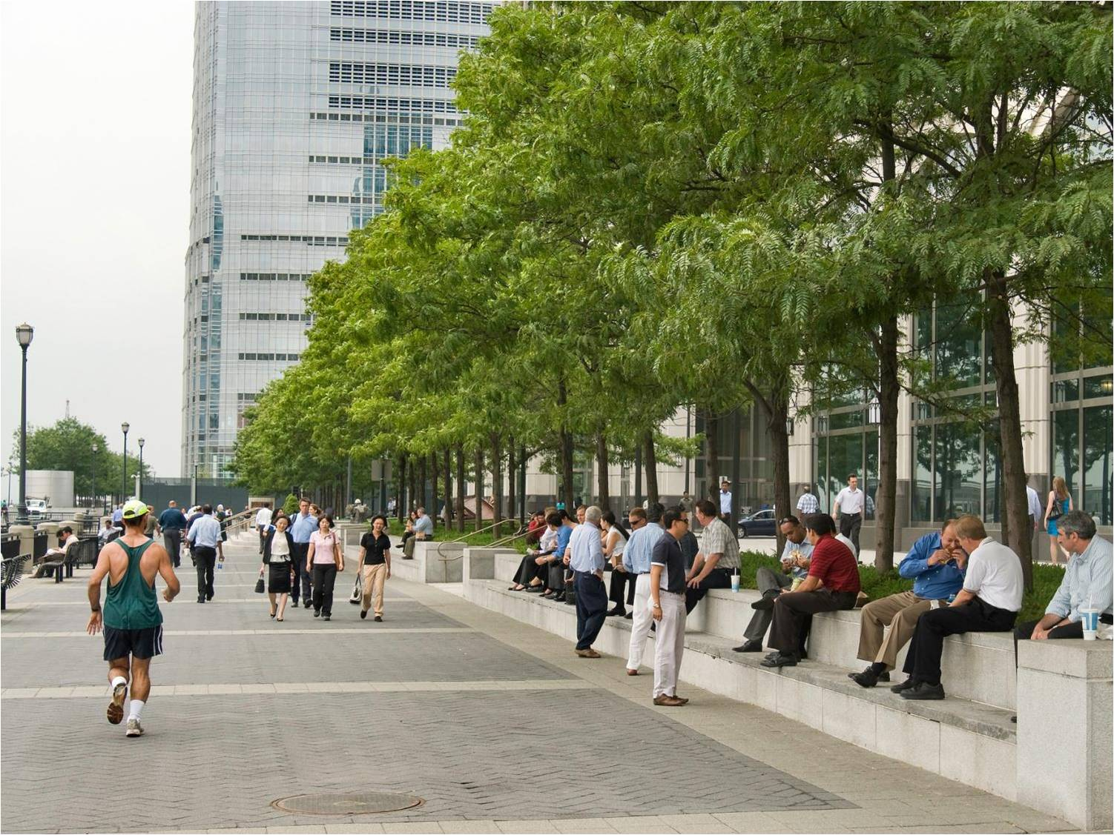
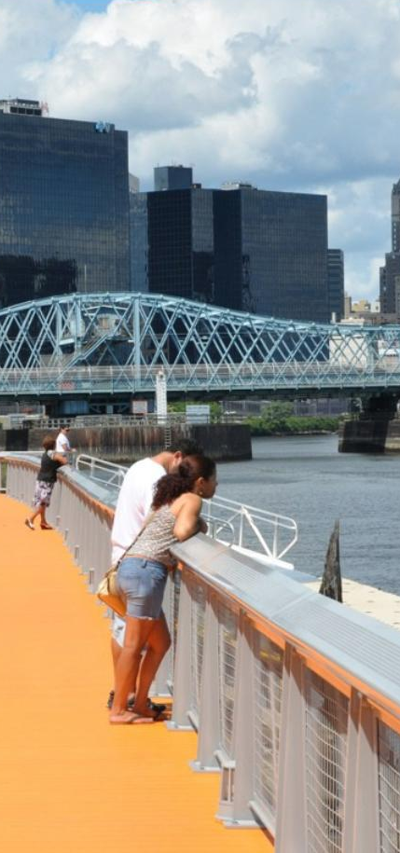

Notes:
Founded in 1987, New Jersey Future is a nonprofit, nonpartisan organization that promotes sensible growth, redevelopment and infrastructure investments to foster vibrant cities and towns, protect natural lands and waterways, enhance transportation choices, provide access to safe, affordable and aging-friendly neighborhoods and fuel a strong economy. The organization does this through original research, innovative policy development, coalition-building, advocacy, and hands-on strategic assistance.

Slide 3
NJDHS Age-Friendly Community Grant
Awarded March, 2025
The Age-Friendly Communities grants are used to build community partnerships, execute a community needs assessment, create an action plan to become an Age-Friendly Community, and enroll in the AARP Network of Age-Friendly States and Communities.

Slide 4
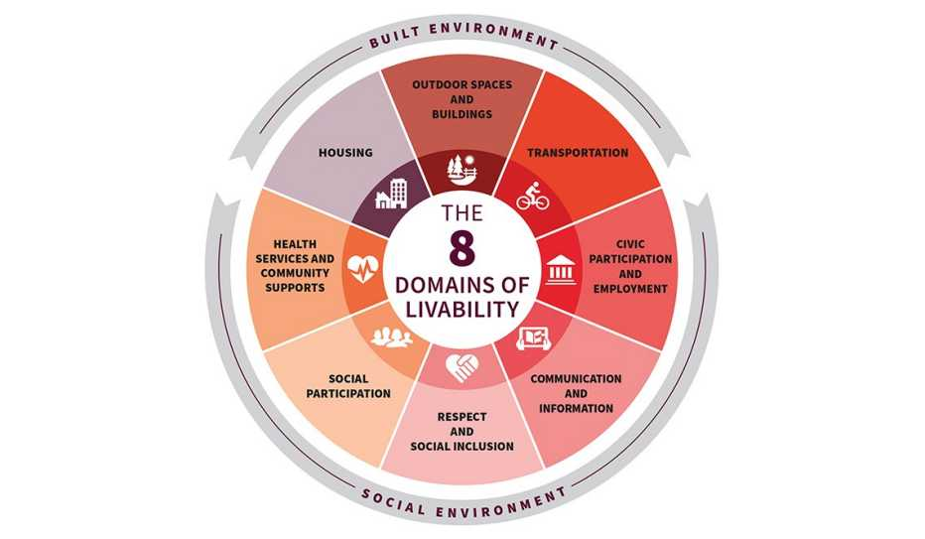
8 Domains of Livability

Slide 5
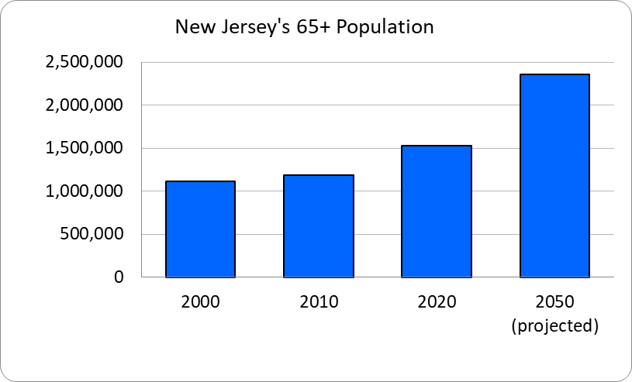
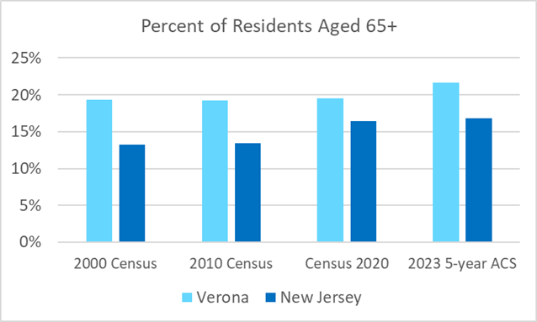
Why Age-Friendly Planning Matters
More than one in five Verona residents is age 65+
Population aging will continue over the coming decades
Supporting residents as they age benefits the entire community
Goal: help residents remain healthy, independent, and engaged

Slide 6
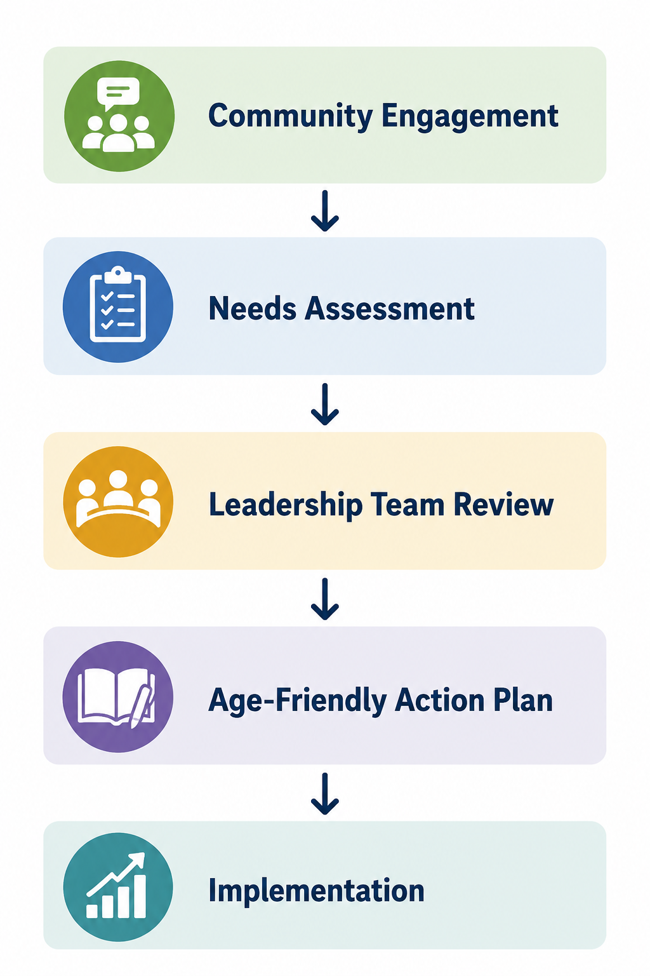
Project Overview
Phase 1: Community Engagement & Capacity Building
Completed:
Leadership Team
Community Needs Assessment
278 survey responses
Focus groups
Community interviews
Final Action Plan
Phase 2: Implementation
Annual progress reporting
Committee oversight
Continuous evaluation
Partnerships

Slide 7
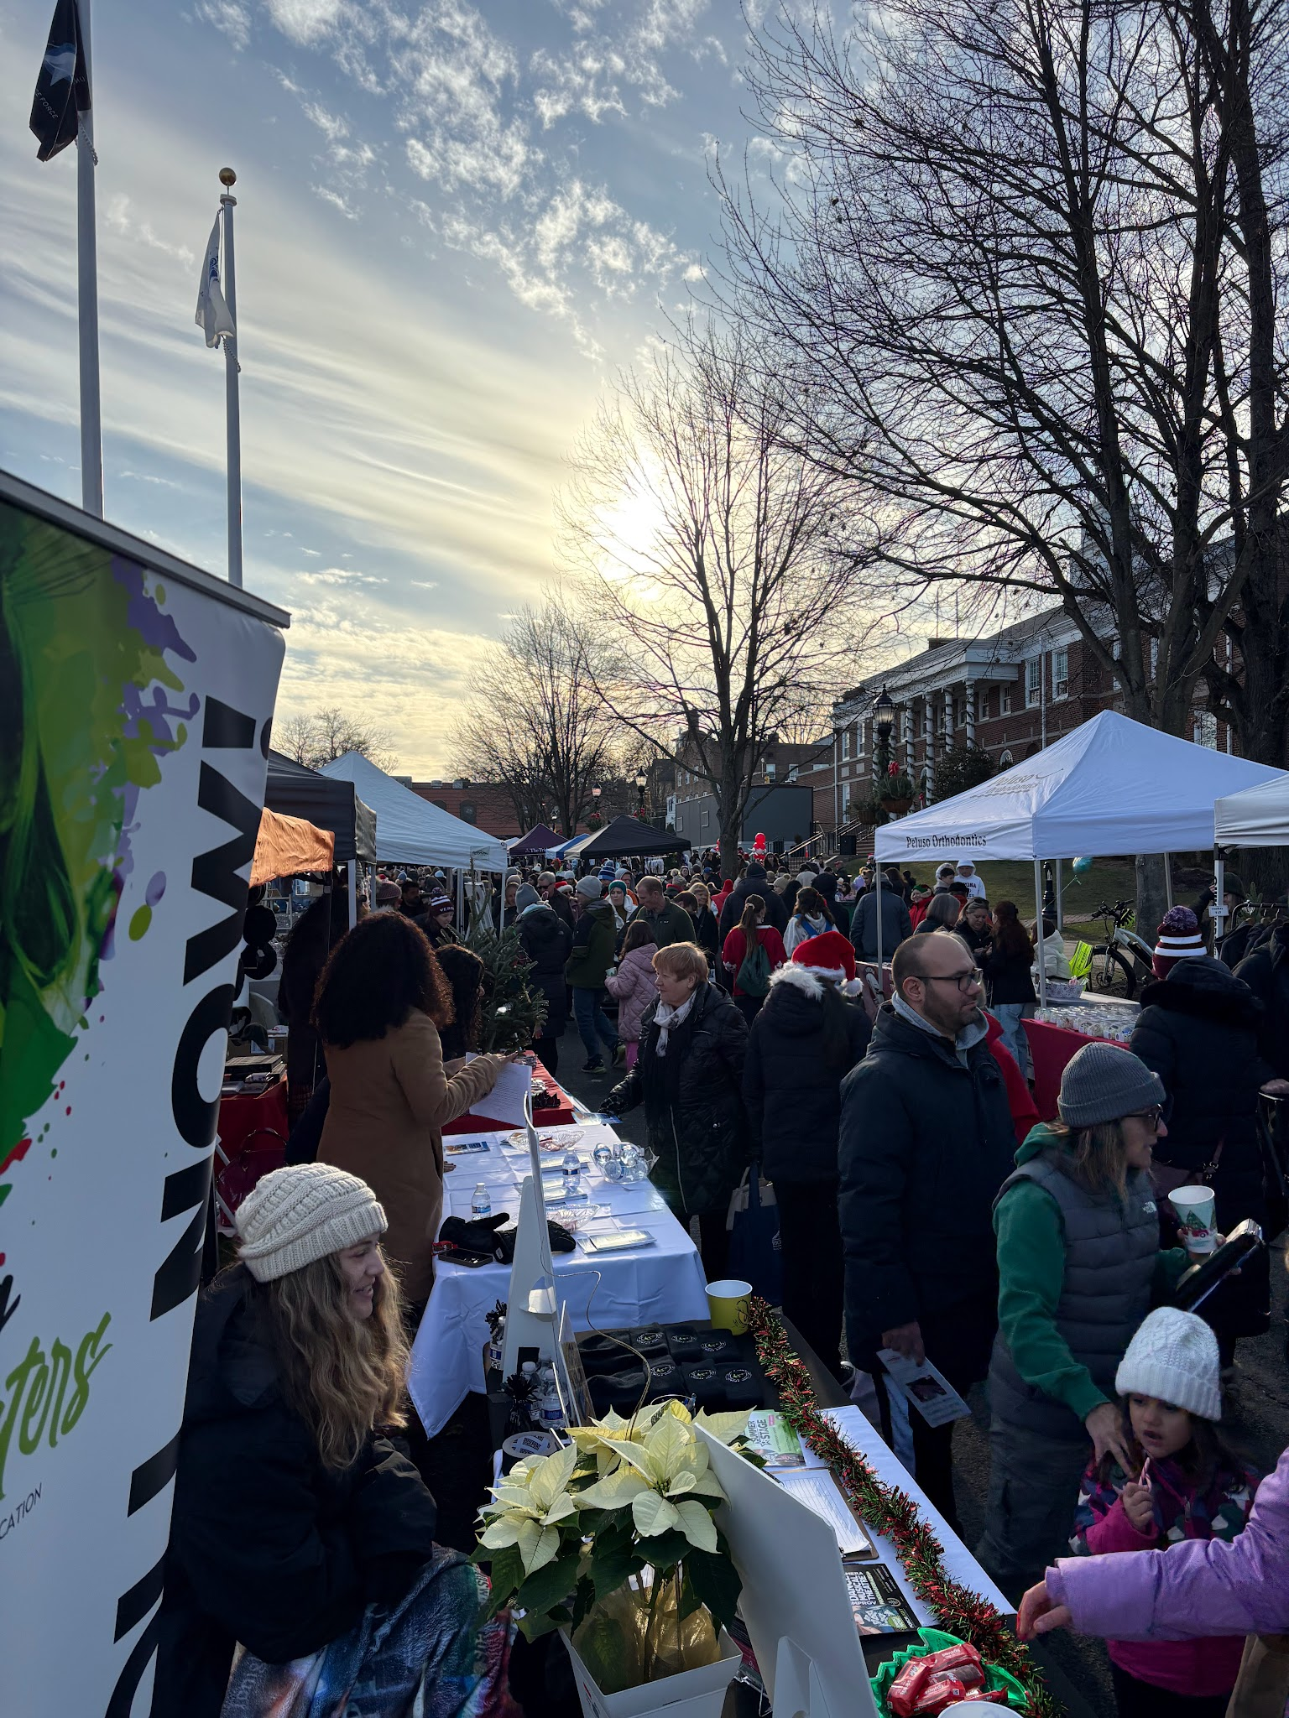
Community Survey
278 total responses
  248 digital (SurveyMonkey)
  30 paper
  Over our goal of 200
Effective outreach strategy
  Mailers, social media, community events, e-newsletter

Slide 8
Focus Groups
2 focus group sessions (Verona Community Center)
Shared concerns:
  Information gaps: senior bus, library services
  Yard work (snow removal, lawn care)
  Difficulty using pay stations for parking
  Senior bus locations
  Redevelopment project units not earmarked for seniors

Slide 9
Interviews
Shared concerns:
  Grove Avenue speed limits not enforced
  Interest in snow removal program
  Not enough people know about the E-Newsletter
  Senior classes need more topics
  Walking club (areas like West Essex Trail, Grove Park, Peckman Park, and the Hilltop)
  Senior Garden Club

Slide 10
Action Plan Framework
Goal 1
  Establish and Sustain an Age-Friendly Initiative
    Formalize an Age-Friendly Sub-Committee
    Integrate age-friendly principles into municipal decisions
    Expand community partnerships
    Pursue grants and Sustainable Jersey recognition
Goal 2
  Remove Barriers to Aging in Place
    Short-Term
    Long-Term

Slide 11
Housing
Focus areas:
Expand downsizing opportunities
Promote affordable and accessible housing
Increase awareness of tax relief
Create a home maintenance assistance program
Residents consistently expressed concern about remaining in Verona as housing costs increase.

Slide 12
2. Transportation & Mobility
Recommended actions:
Evaluate Senior Bus and Medical Transport Bus services
Improve awareness of transportation options
Expand destinations
Support residents transitioning away from driving
Explore partnerships and shuttle opportunities

Slide 13
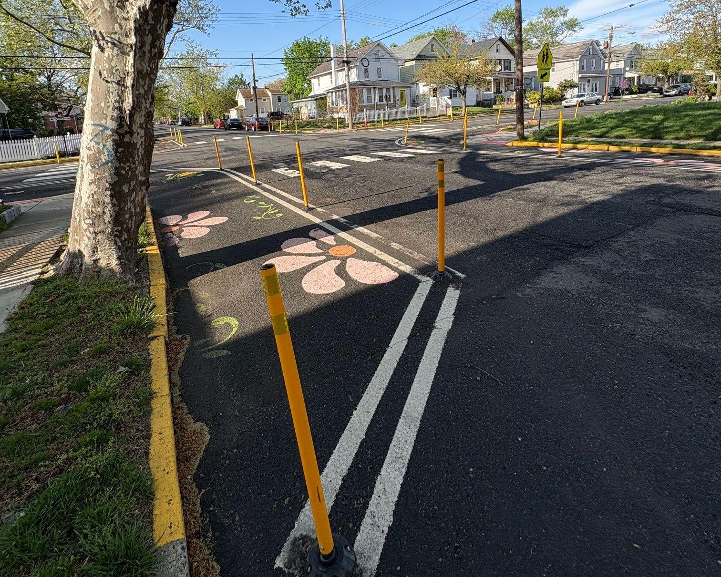
3. Walkability
Recommended actions:
Community walkability audit
Improve pedestrian crossings
Add benches and resting areas
Address speeding concerns
Strengthen winter accessibility
Improve emergency preparedness
Many of the major roadway issues highlighted by survey respondents and focus group participants involve Essex County-owned roadways, such as Bloomfield Avenue. This creates limitations on what the Township can directly address. However, the findings of the needs assessment can be leveraged by the Township to advocate for County road improvements through direct community engagement.

Slide 14
4. Communication & Information
Lack of awareness of available services emerged consistently throughout engagement efforts.
Recommendations:
Age-Friendly Verona webpage
Printed resource guide
Senior Services Fair
Better promotion through partners
Single information hub

Slide 15
5. Social Connection
Expand opportunities for:
Recreation
Wellness
Walking groups
Educational programming
Volunteer opportunities
Intergenerational activities
Municipal committee participation

Slide 16
Looking Forward: Priority Actions
Establish the Verona Age-Friendly Sub-Committee of MIAAC.
Conduct a housing and downsizing assessment.
Launch a home maintenance and snow assistance program.
Conduct a ridership audit and improve Senior Bus and Medical Transport Vehicle services.
Conduct a community walkability and pedestrian safety audit.
Create a centralized senior information hub and resource guide.
Expand recreation, wellness, and social programming.
Improve and publicize pathways to volunteer and civic engagement.
Increase outreach regarding tax relief and financial assistance programs.
Create an annual Age-Friendly Verona Progress Report.

